Slide 1
Secure data hiding in images using steganography
CAPSTONE PROJECT
Presented By: Vatsalya
Student Name : Vatsalya
College Name & Department : MAHGU Uttarakhand & IT

Slide 2
OUTLINE
Problem Statement
Technology used
Wow factor
End users
Result
Conclusion
Git-hub Link
Future scope

Slide 3
Problem Statement
This project is a Cyberpunk-Themed Steganography Tool that securely hides encrypted messages within images. Users can encrypt, embed, and decrypt messages using a password, ensuring discreet communication. With a futuristic UI, neon animations, sound effects, and a progress bar, it provides a seamless and interactive experience for secure data transmission without altering the cover image. 🚀

Slide 4
Technology used
Technologies Used 🚀
Python 3.12 – Core programming language
Tkinter – GUI development
OpenCV – Image processing
Cryptography (Fernet) – Encryption & decryption
Pygame – Sound effects
PIL (Pillow) – Image handling
Threading – Asynchronous processing
NumPy – Efficient image data manipulation

Slide 5
Wow factors
⚡ Instant Encryption & Decryption – Optimized processing ensures quick message hiding and retrieval.
🔒 Secure Communication – Uses AES-based Fernet encryption for strong security.
📷 Image Preview – Allows users to see the selected image before encoding/decoding.
🎚️ Real-Time Progress Bar – Displays encoding & decoding progress dynamically.
🎵 Interactive Sound Effects – Pygame-powered sounds enhance user interaction.
📂 User-Friendly File Selection – Simple UI for choosing images effortlessly.
🚀 Multithreading for Speed – Ensures a lag-free experience by running tasks in the background.
🖥️ Cross-Platform – Works smoothly on Windows, macOS, and Linux.

Slide 6
End users
🔐 Cybersecurity Enthusiasts – People interested in secure communication and data hiding techniques.
📢 Journalists & Activists – Need to share sensitive information discreetly without attracting attention.
💼 Corporate Professionals – Secure internal communications and confidential file sharing.
👨‍💻 Ethical Hackers & Researchers – For studying and experimenting with steganography techniques.
🎮 Gamers & Modders – Can use it for hiding secret messages or Easter eggs in game assets.
🕵️ Government & Intelligence Agencies – Securely transmit classified information.
📖 Students & Educators – Useful for learning cryptography, steganography, and cybersecurity concepts.
🎭 Privacy Advocates – Individuals who prioritize data privacy and secure communication

Slide 7
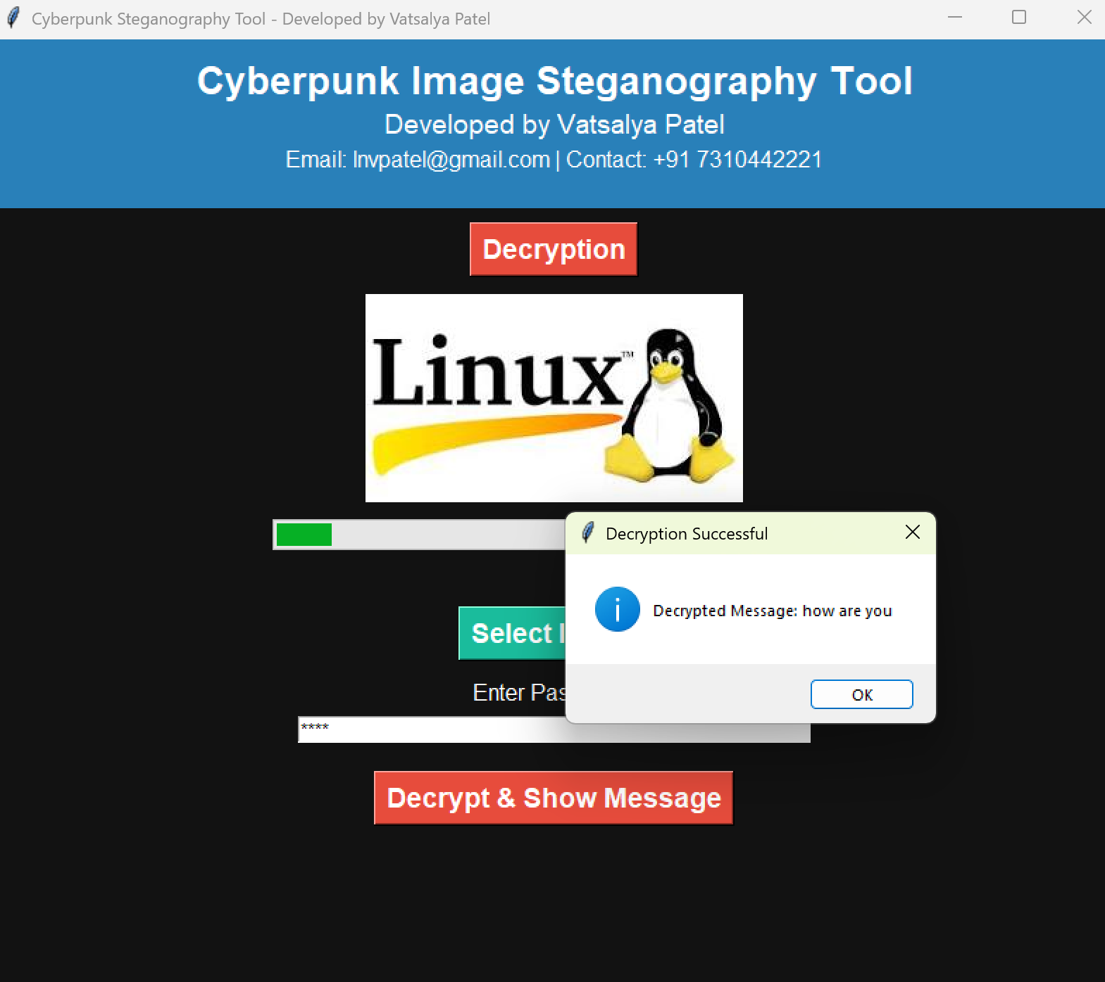
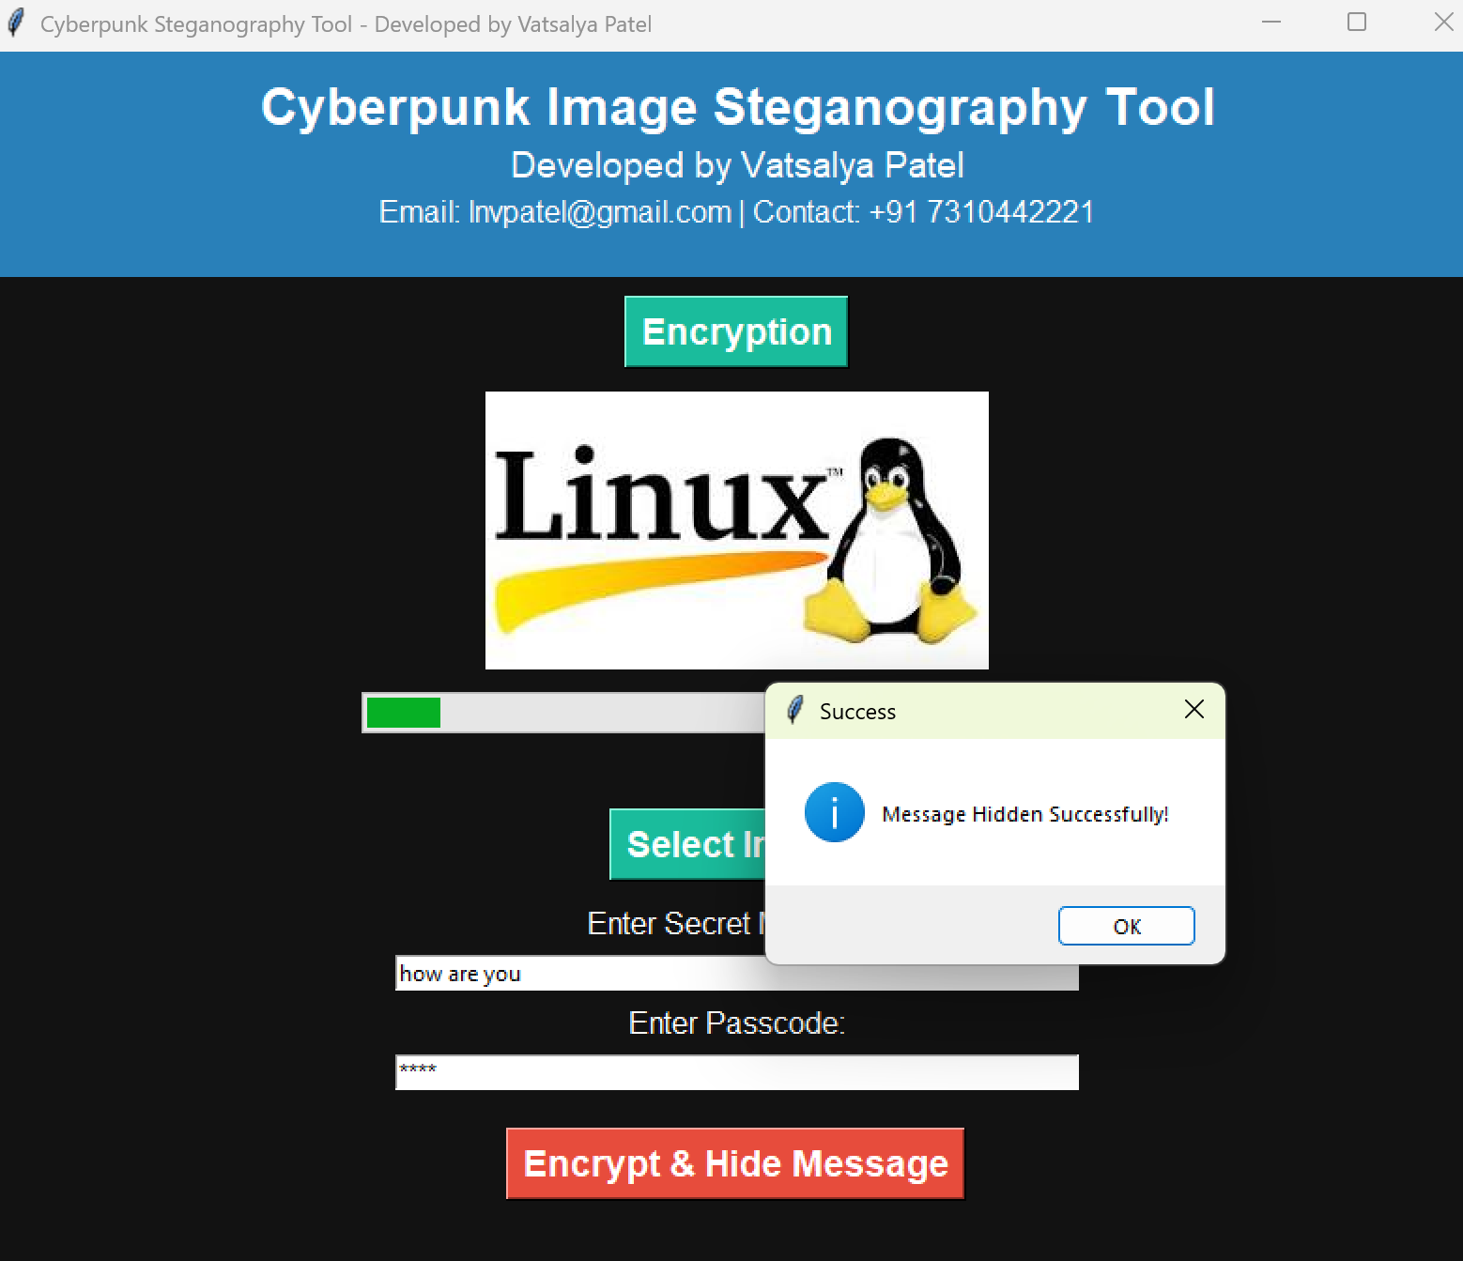
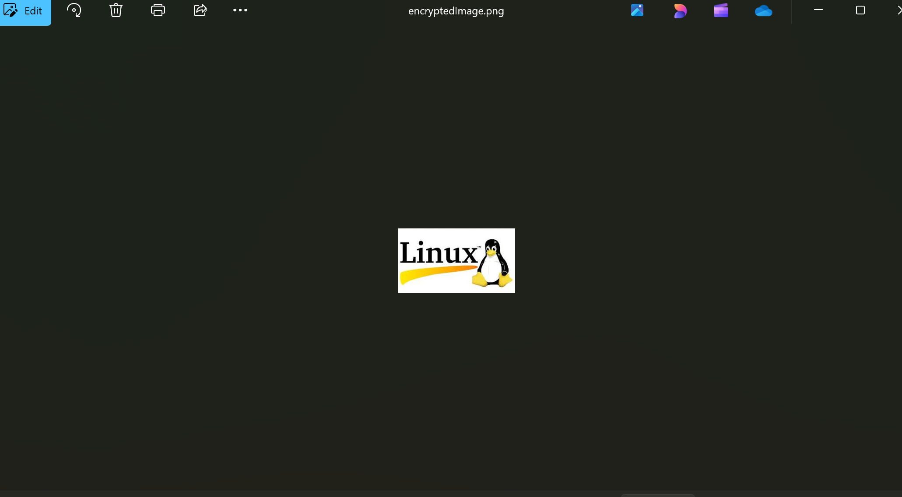
Results

Slide 8
Conclusion
This Cyberpunk Steganography Tool effectively addresses the challenge of securely embedding and retrieving encrypted messages within images. By integrating advanced cryptography and steganography, it ensures confidential data transmission without drawing attention. The futuristic cyberpunk UI, along with real-time encryption, decryption, and progress indicators, enhances user experience. This project serves as a powerful tool for cybersecurity enthusiasts, journalists, corporate professionals, and privacy advocates, offering a seamless and secure way to communicate sensitive information. 🚀🔐

Slide 9
GitHub Link
https://github.com/lnvpatel/stagenography_aicte.git

Slide 10
Future scope(optional)
Enhanced Encryption Techniques – Implement more advanced cryptographic algorithms to strengthen security.
Steganography for Videos & Audio – Extend functionality to conceal messages in video and audio files.
Cloud-Based Steganography – Enable secure online encoding and decoding without local processing.
AI-Powered Detection Resistance – Use AI to enhance resistance against steganalysis tools.
Cross-Platform Compatibility – Develop web and mobile versions for wider accessibility.
Blockchain Integration – Leverage blockchain for tamper-proof message verification.
Real-Time Encryption – Improve encoding speed for instant secure communication.
User-Friendly Enhancements – Add voice commands, biometric authentication, and UI improvements.
This project has strong potential to evolve into a next-generation cybersecurity tool for secure, hidden communication in various sectors. 🚀🔐

Slide 11
THANK YOU

